Slide 1
Hi, I’m Rachel Irabor
Microsoft MVP
AI Agent
Power Platform
Dynamics 365 CRM
•
•
•
•
Today: building a multi-agent AI procurement solution
#FollowAlongWithRachelIrabor

Slide 2
Why a multi-agent approach?
The procurement scenario
We’re building an AI solution for procurement that brings together two distinct areas:
supplier risk + contract lifecycle management
Supplier Risk
Contract Lifecycle
Supplier health, risk indicators,
performance and issues requiring attention.
Procurement
Contract status, key dates,
renewals and actions requiring attention.
Orchestrator
Why not one general-purpose agent?
These are different capabilities with different responsibilities, data and actions. The orchestrator can route each request to the specialist
that understands that domain.

Slide 3
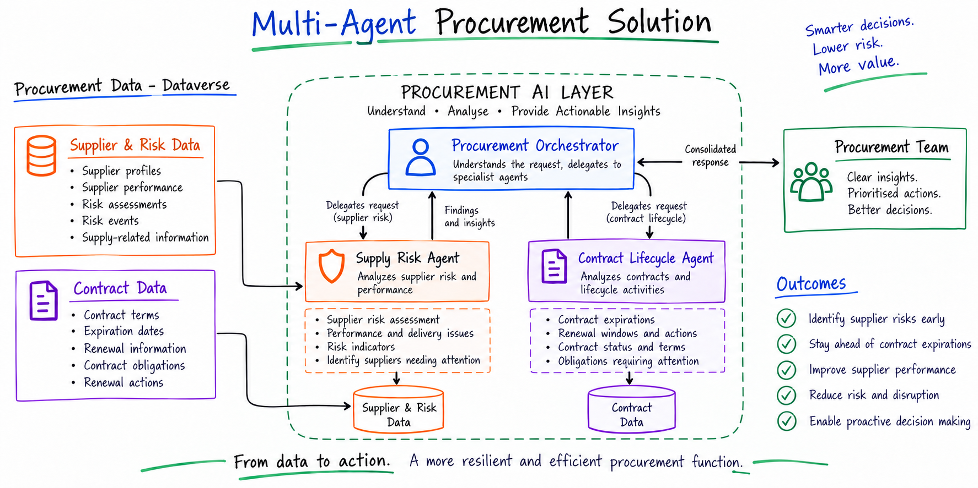
Solution architecture
The architecture we’ll build

Slide 4
Security & Governance by Design
LEAST PRIVILEGE
READ-ONLY DATA ACCESS
AGENT BOUNDARIES
Each specialist agent only handles the
procurement capability it is designed for.
The Dataverse MCP Server exposes
only the tools required to read and
analyze data.
The Orchestrator coordinates; specialist
agents analyze within their defined skills.
• Supply Risk → risk & performance
• Contract Lifecycle → contracts & obligations
• describe
• search
• read_query
• No create / update / delete
• Orchestrator → routes & coordinates
• Specialists → analyze their domain
EVIDENCE-BASED AI
Agents use retrieved Dataverse data, distinguish stored facts from derived findings, and do not invent procurement information.
“The agents can reason over procurement data but they cannot change it.”

